Slide 1
Capacity Strengthening
Susan Legro, MIA/MPH
May 20, 2024

Slide 2
Overview
When is capacity strengthening the right choice?
Before you start
Finding the right tools

Slide 3
Levels of Capacity
Institutional
Organizational
Individual

Slide 4
When capacity strengthening is (and isn’t) a solution
“What is the biggest problem you face (if any) when carrying out your work?
Three types of answers:
Problems that can be addressed
Need to learn how to use a new data platform
Problems that may be possible to address
Need for improved data collection
Problems that can’t be addressed
Incomplete legislation in the field of air pollution
Inadequate funding or staffing

Slide 5
Finding the Right Tools
Step 1: Identify Goals
Step 2: Determine Tasks Necessary to Meet Goals
Step 3: Talk to your team
Step 4: Determine Learning Activities
Step 5: Talk to your team again
Step 6: Select your tools
Step 7: Evaluate and adjust

Slide 6
Step 3: Questions to Ask
Are there needs that you are not aware of?
Are there needs that your employees are not aware of?
Are there organizational or institutional needs?

Slide 7
Types of Content to be Shared
Facts
“What is the allowable limit for particulate emissions?”
Concepts
“Vehicle emissions are mobile source emissions.”
Processes
“How is an annual report compiled?”
Procedures
“How do I download data from the vehicle emissions registry?”
Principles
“These are the guidelines to be applied when extrapolating data
Troubleshooting
“What should I do if emissions are not appearing on the reporting forms?”

Slide 8
Other content
Management skills
“Soft” skills

Slide 9
Step 5: Questions to Ask
What other kinds of training and capacity strengthening have your staff or experts whose work you oversee participated in over the past 2-3 years?
What capacity strengthening resources can your organization offer?
What problems do you foresee (e.g. limited time for training, staff turnover, etc.)?”
Notes:
Topical trainings on air pollution
Implementation of multilateral environmental agreements
Broader civil service training
Other topical trainings

Slide 10
Your Toolbox
Briefings
Twinning
Training
Networks /
Communities of Practice
Study Tours
Mentoring
Coaching

Slide 11
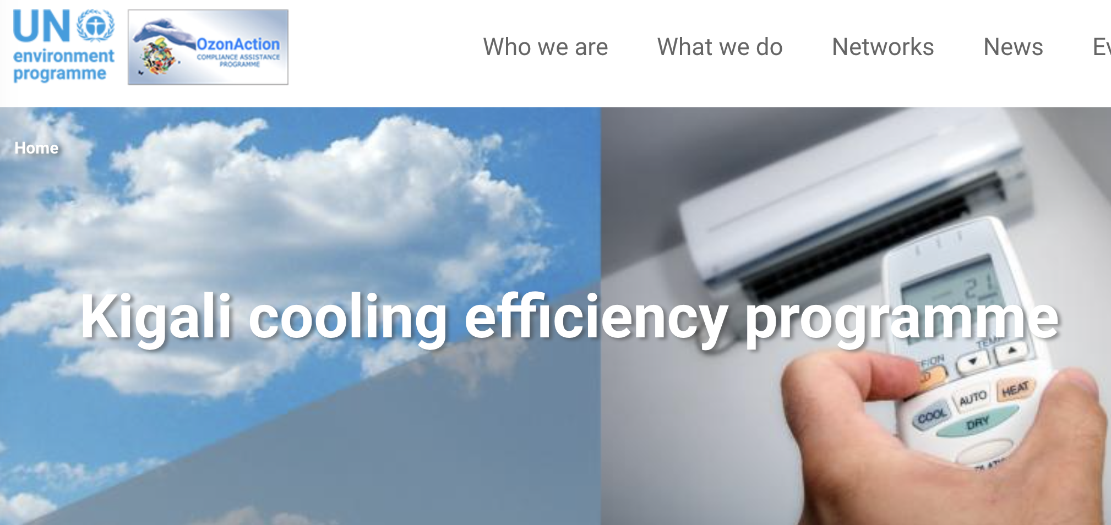
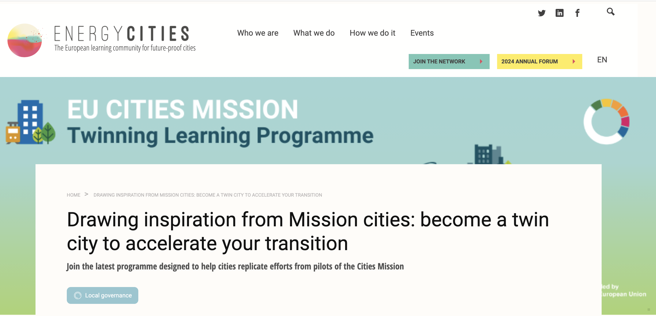
Examples

Slide 12
Draft Plan
Timing | Goal | Type of Capacity Strengthening | Content | Target Group(s) | Provider / Resources

Slide 13
What Makes a Capacity Strengthening Measure Successful?
Quality of design and organization
Training and organizational needs are well-matched
Good fit with individual needs

Slide 14
Other Recommendations
Consider virtual activities
Take advantage of existing resources and programs

Slide 15
Thank you for your attention!
Susan Legro
susan@ecoltdgroup.com

