Slide 1
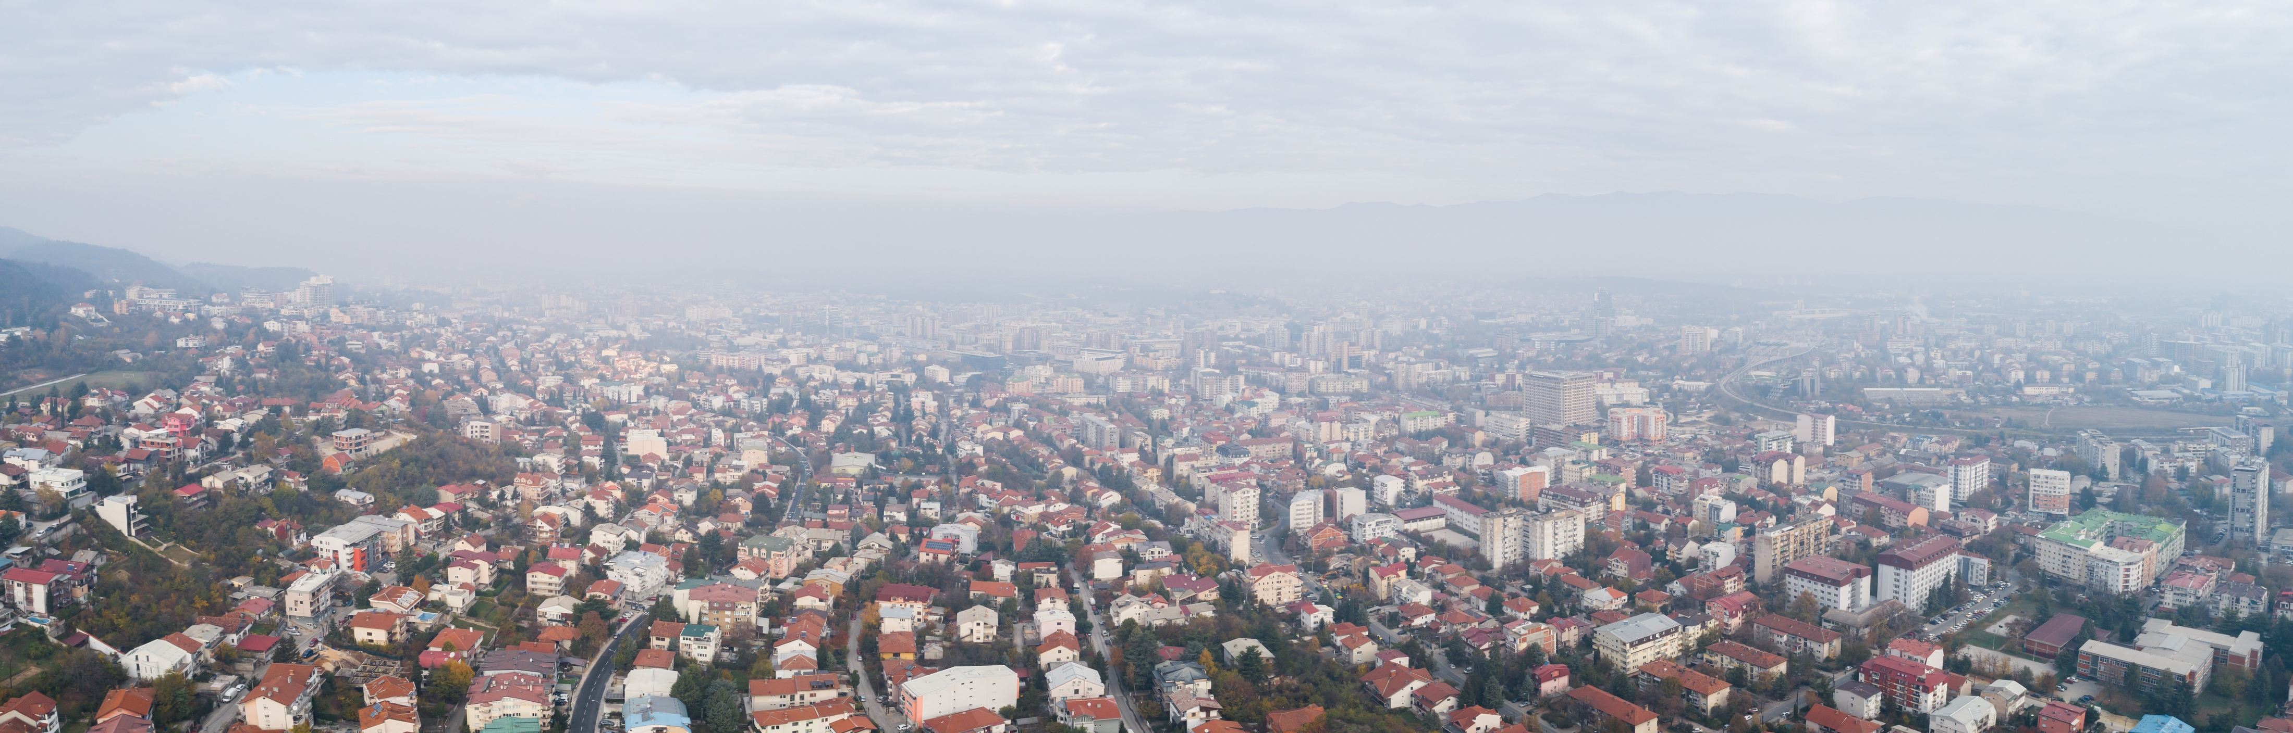


Source apportionment study for Skopje urban area
Prof. Dejan Mirakovski – UGD Stip

Slide 2

About the Study
The Source Apportionment Study for Skopje Agglomeration was preprepared by AMBICON UGD Lab, as a part of Tackling Air Pollution in the City of Skopje Project, implemented by UNDP-Skopje and SIDA- Sweden’s government agency for development cooperation, and supported by Ministry of Environment and Physical Planning and City of Skopje.
The primary objective of the Source Apportionment (SA) study for the Skopje Agglomeration was to obtain information about pollution sources and the extent to which they contribute to ambient air pollution levels, as an essential tool in the design of air quality policies, as required explicitly or implicitly for the implementation of the Air Quality Directives (Directive 2008/50/EC and Directive 2004/107/EC).
Notes:
preprepared by AMBICON Lab, as a part of Tackling Air Pollution in the City of Skopje Project, implemented by UNDP-Skopje and Sweden’s government agency for development cooperation.
Primary objective of the study was to obtain information about pollution sources and the extent to which they contribute to ambient air pollution levels, as an essential tool in the design of air quality policies.

Slide 3
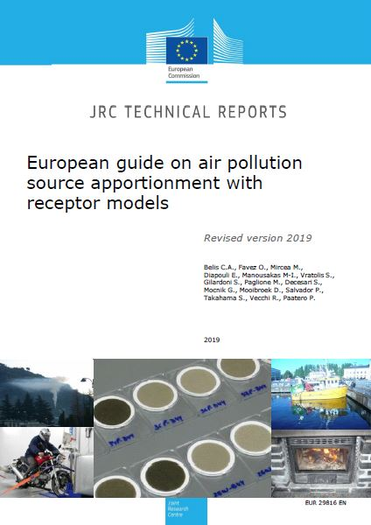
SAS and RMs ?
Source apportionment (SA) is the practice of obtaining information about pollution sources and the amount of pollution that each source contributes to the level of ambient air pollution. Emission inventories, source-oriented models, and receptor-oriented models are three ways that can be used to do this task.
Receptor models are mathematical methodologies for measuring the contribution of sources to samples based on their composition or fingerprints.
Notes:
Source apportionment (SA) is the practice of obtaining information about pollution sources and the amount of pollution that each source contributes to total pollution level.
There are three ways that can be used to do this task, Emission inventories, source-oriented models, and receptor-oriented models.

Slide 4
Positive Matrix Factorisation
The goal of receptor models is to solve the chemical mass balance between measured species concentrations and source profiles.
Common factor analysis methods used include Principal Component Analysis (PCA), Unmix, Target Transformation Factor Analysis (TTFA), Positive Matrix Factorization and Multilinear Engine (PMF - ME).
RM trends in Europe 2001-11 (Karagulian and Belis, 2012)
Notes:
Receptor models try to solve the chemical mass balance between measured species concentrations and source profiles. There are also several ways to do this modelling, and we use PMF as most frequent approach in recent SAS done in Europe.

Slide 5
How we did it?
The project preparations and field works set up were started during the late October 2020 and officially commenced from start of January 2021, and included following activities:
Selection of representative receptors/monitoring sites
2 Permanent sites - 24 hour interval, 365 days (> 90% coverage over the year)
3 indicative 3 sites - 24 hours interval, 14 consecutive days per season or 56 days per year
Sampling + Chemical speciation
Gravimetric sampling on PTFE filters in accordance with EN 12341:2014
Determination of chemical composition of ambient particulate matter collected on filter
Construction of multivariate receptor model for all receptors
Compilation of concentrations and uncertainty data matrices
Robust Positive Matrix Factorization (PMF)
Source Apportionment study drafting
Site specifics, source inventories, source profiles, time series for pollutant of interest
Reporting results and methodology
Notes:
project preparations and field works set up were started during the late October 2020 and officially commenced in January 2021, and included following activities:
Selection of representative receptors,
Sampling and chemical speciation,
Construction of models
Study drafting

Slide 6
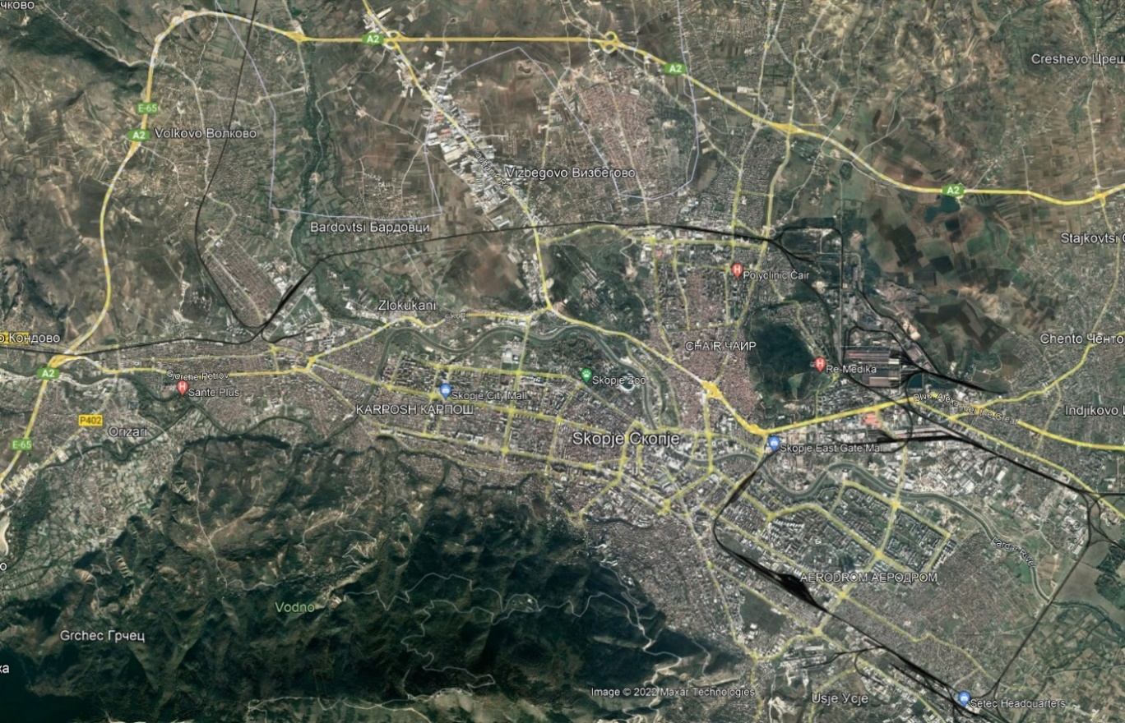
Monitoring sites
Considering the SA study goals, current data availability, as much as the project document requirements, in total five (5) specific receptors/sampling points were selected and set within Skopje agglomeration. 2 of the sites were set as permanent (full year coverage) and other 3 as indicative (14 days per season coverage).
Notes:
Considering the SA study goals, in total five (5) specific receptors/sampling points were selected, 2 selected as permanent (full year coverage) and 3 as indicative (2 weeks per season coverage)

Slide 7
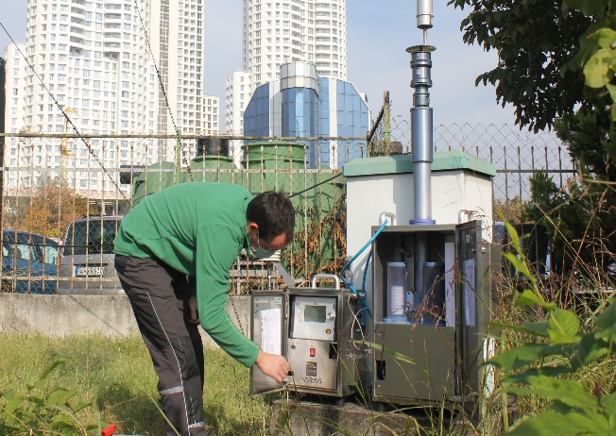
Sampling
Sampling process was performed fully in line with the requirements of standard gravimetric measurement method for determination of the PM10/PM2,5 mass concentration of suspended particulate matter (EN 12341:2014), and according to standard operating procedure of UGD AMBICON Lab.
Low Volume Sequential Sampling Systems (PNS 18 -6.2 DM, Comde Derenda, Germany) were used at all sites. The sampling systems are certified as a reference devices for PM10 and PM2.5 according to EN 12341:2014 (TÜV Süd, Germany).
Notes:
Sampling process was performed in line with standard gravimetric measurement method for determination of the PM2,5 (EN 12341:2014), using referent Low Volume Sequential Sampling Systems.

Slide 8
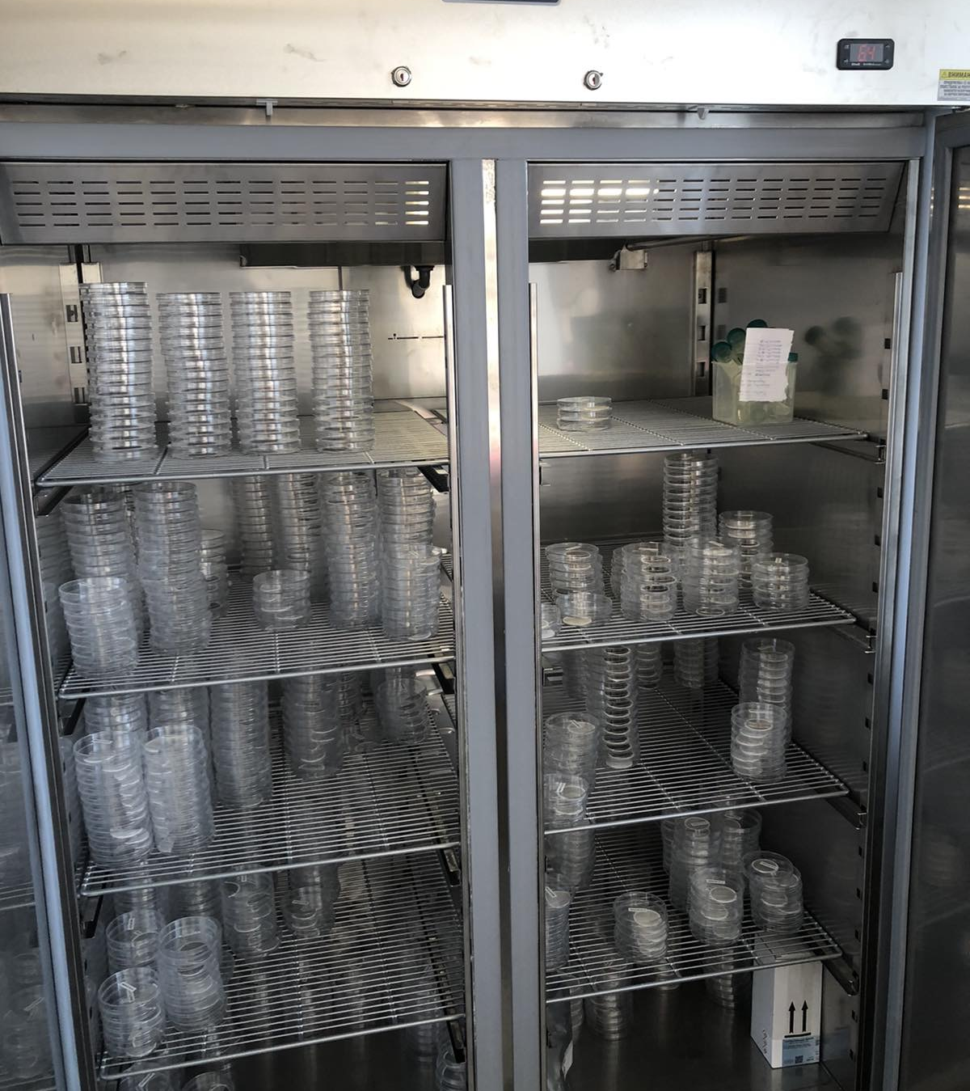
Sampling
Sampling programs were simultaneously launched at two permanent and one indicative site on 29.10.2020 and ended on 04.12.2021.
During this period a total of 376 samples were taken at Karposh sampling site (MP1-AQP), 367 at Lisiche sampling site (MP2-AQP) and 60 samples at each of the indicative sampling sites (MP3-AQT, MP4-AQT and MP5-AQT).

Slide 9
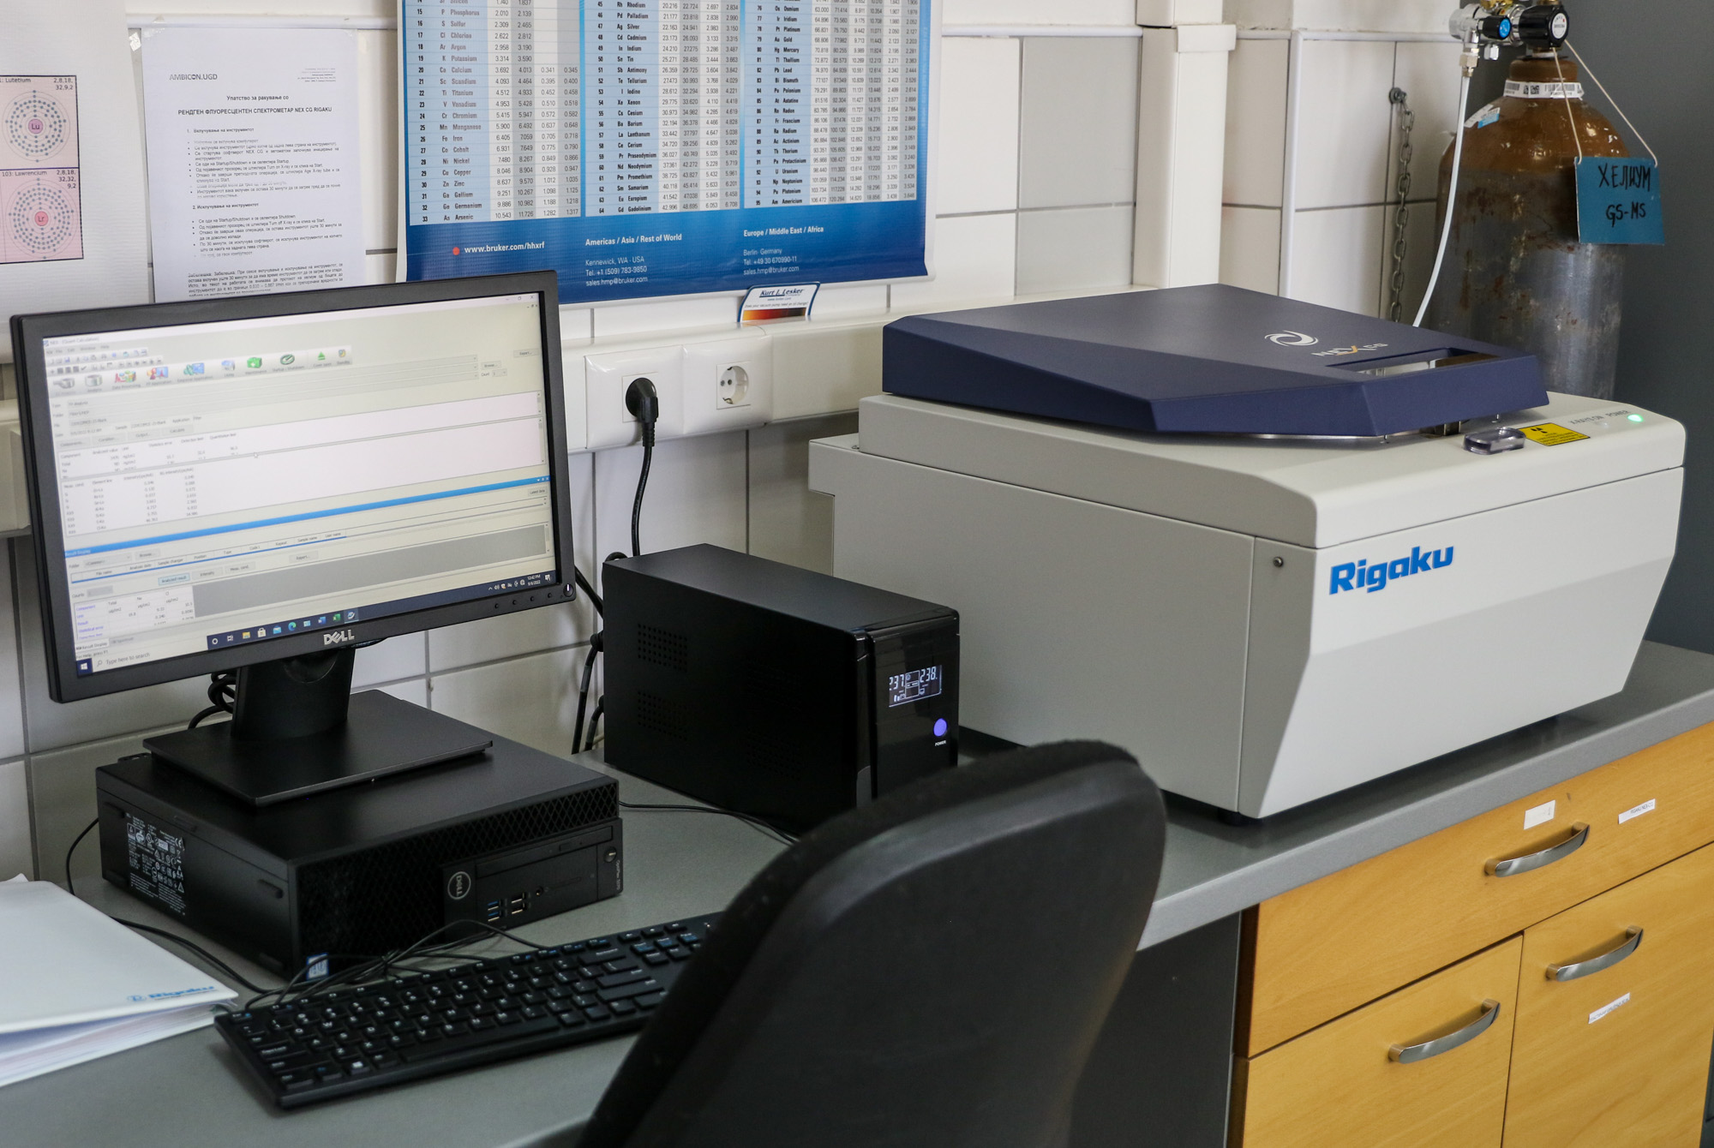
Chemical speciation
The elemental analysis of PM2.5 aerosols was performed using an energy dispersive X-ray fluorescence spectrometer (NEX CG, Rigaku, Japan) in line with EPA method IO-3.3. The calibration curve was created using the NIST-approved standard multy elemental reference material SRM 2783, and Micromatter's certified reference materials.
Using this non-destructive technique, a total of 27 elements (Na, Mg, Al, Si, S, K, Ca, Ti, Cr, Mn, Fe, Co, Ni, Cu, Zn, As, Sc, V, Rb, Sb, Ba, Ce, W, Pb, Th, Cl and Cd) were analysed directly on filter in a pure helium atmosphere.
Notes:
Elemental analysis of PM2.5 aerosols was performed using an energy dispersive X-ray fluorescence spectrometer (NEX CG, Rigaku, Japan) and using this non-destructive technique, a total of 27 elements were determined.

Slide 10

Chemical speciation
Elemental Carbon in PM was quantified using a Magee Scientific SootScan Model OT21 Optical Transmissometer with a dual wavelength light source and utilising the EPA empirical EC relation for Teflon FRM filters.
Notes:
Elemental Carbon in PM was quantified using a Magee Scientific OT21 Optical Transmissometer

Slide 11

Chemical speciation
Water-soluble ions, including sulphate (SO₄²⁻), nitrate (NO₃⁻) and ammonium (NH₄⁺), were determined using internally developed extraction procedure and referent photometric methods with ready to use sensitive cell tests in accordance with ISO 7150-1 and DIN 38406-5 for NH₄⁺, EPA 375.4 for SO₄²⁻ and DIN 38405-9 for NO₃⁻.
Notes:
Water-soluble ions, including sulphate (SO₄²⁻), nitrate (NO₃⁻) and ammonium (NH₄⁺), were determined using internally developed extraction procedure and referent photometric methods with ready to use sensitive cell tests.

Slide 12
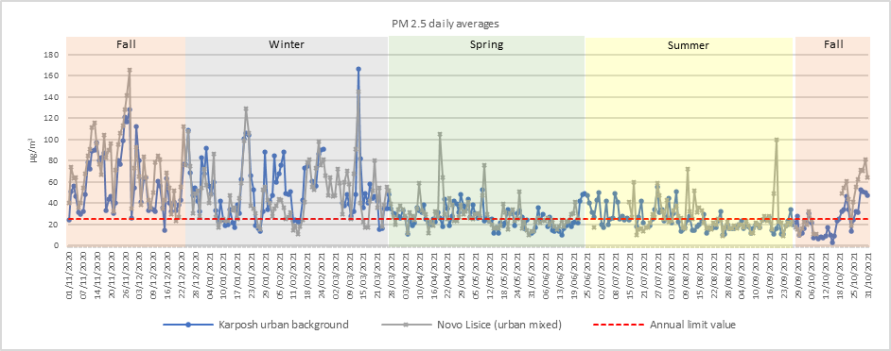
Resluts

Slide 13
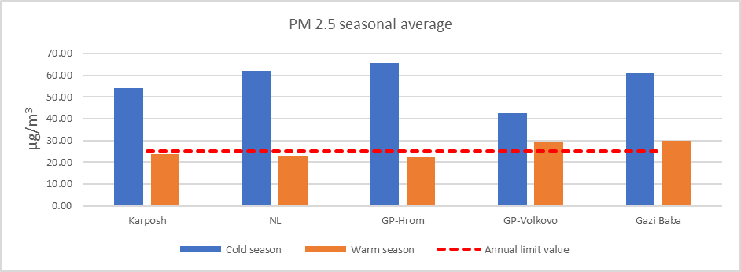
Mass concentrations
Daily average PM2.5 concentrations measured at all monitoring sites in Skopje urban area, exhibits significant seasonal variability, exceeding all of the European Union's limit, target, and threshold values for human health protection.
Notes:
PM2.5 concentrations measured at all monitoring sites in Skopje urban area, exhibits significant seasonal variability, and unfortunately exceed all of the limit, target, and threshold values, with significantly higher concentrations recorded during the cold months.

Slide 14
Mass concentrations
Average annual concentrations PM_{2,5} (µg/m³)
Europe average (Putaud et al., 2019) | 3 ÷ 35
Gazi Baba - industrial | 46,62 ± 34,20
Novo Lisiche – traffic and industrial | 45,68 ± 28,85
Hrom - residential | 43,98 ± 30,26
Karposh – urban background | 36,41 ± 36,40
Volkovo - rural | 35,75 ± 23,58
The highest mass concentrations were determined in Gazi Baba (46.62 ± 34.20 µg/m3), followed by Novo Lisiche (45.68 ± 28.85 µg/m3), Gorce Petrov – Hrom (43.98 ± 30.26 µg/m3), Karposh (36.40 ± 24.18 µg/m3) and Gorce Petrov – Volkovo (35.75 ± 23.58 µg/m3). The particulate mass (PM 2.5) concentrations measured in Skopje, were among the highest reported in the Europe (PM2.5 annual average concentrations observed in Europe were found from 3 to 35 µg/m3) [26].
Percentage of days exceeding annual limit values for PM 2.5 (25 µg/m3) was 62.30 % for Novo Lisiche (195 out 313 valid daily values) and 58.97 % for Karposh site (194 out 329 valid daily values), with significantly higher concentrations recorded during the cold months.
Notes:
The particulate mass (PM 2.5) concentrations measured in Skopje, were among the highest reported in the Europe.
And actauly for Novo Lisiche site annual limit values were exceeded for 195 out 313 valid daily values, and for Karposh site limite values were exceeded for 194 out 329 valid daily values.

Slide 15
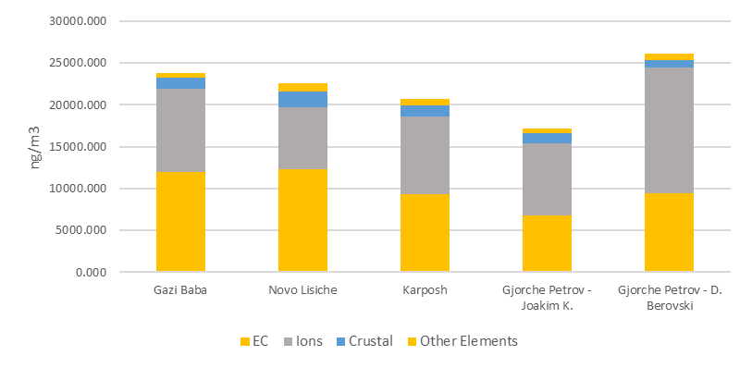
Chemical composition
Contribution of soil (mineral) dust observed in Skopje is similar to the values found in other parts of Europe [26]. Elements like Mg, Al, Si, Ca, Ti and Fe, usually used as tracers for soil dust, are well corelated, indicating common source for these elements.
Sea salt contributions are negligible, as would be expected for a typically continental location.
Sulphates and nitrates contributions are within the lower range of values recorded across Europe, and were found similar to the values recorded in Southern Europe. Although this could be attributed to several factors, a relatively low average concentrations of their gaseous precursors like sulphuric and nitrous oxides must be noted.
However, elemental carbon (EC) contributions found in the urban area of Skopje are higher than European averages and fall within the range of those found in Central Europe, likely reflecting the mix of local sources, where wood combustion was identified as the most significant single source of particulate matter emission.
Notes:
Due to the fact that the majority of the pollutant concentrations in the Skopje valley originate from local emissions and are exacerbated by the local topography, along with poor atmospheric mixing conditions, this urban area typically displays an extremely homogeneous pollution field, both spatially and by component.
Contribution of soil/mineral dust observed in Skopje was similar to be similar to values found in other parts of Europe, Sea salt contributions are negligible. Sulphates and nitrates contributions are within the lower range of values recorded across Europe, but elemental carbon (EC) contributions in Skopje were significantly higher than European averages.

Slide 16
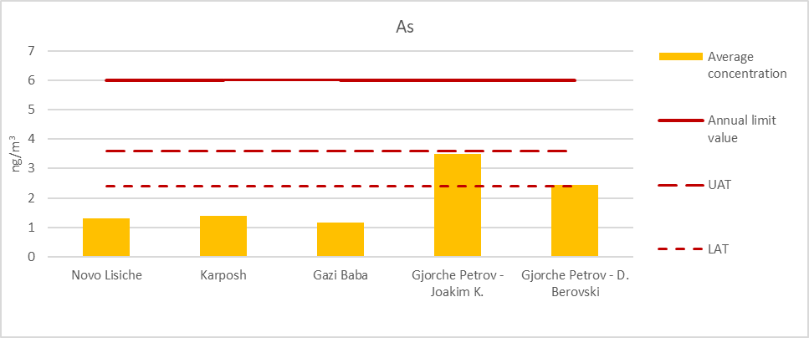
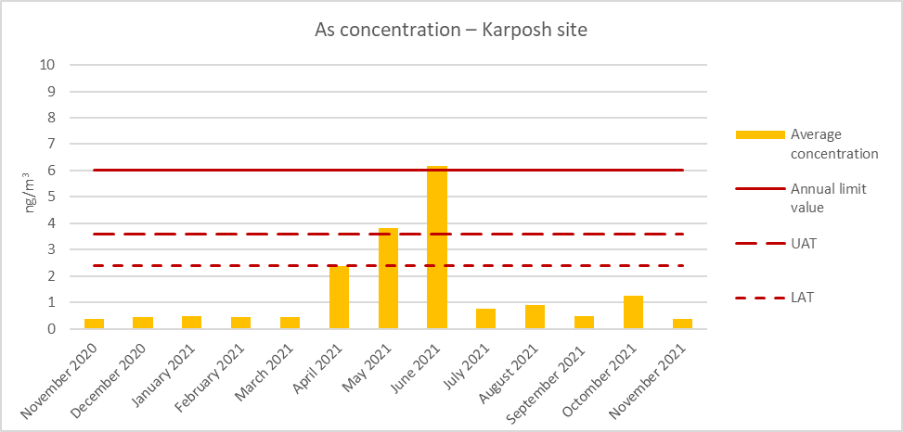
Regulated elements (metals)
It was determined that the concentrations of regulated metals including lead, arsenic, and nickel were within the annual limit, upper assessment threshold, and lower assessment threshold values specified in Directives 2008/51/EC and 2004/71/EC. However, at two sites (Volkovo and Gorce Petrov), As concentrations were at or above the lower assessment target.
Cadmium was precluded from evaluation because over 80% of the readings were close to or below the method detection limit.

Slide 17
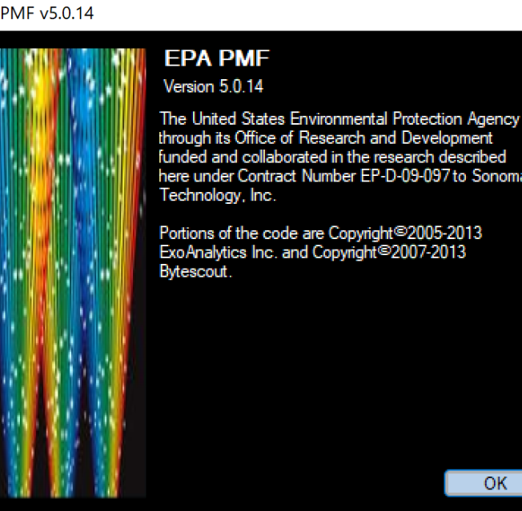
Receptor Modeling
Notes:
Using the chemical composition data obtained the modelling exercise’s were performed with US-EPA PMF 5.0 software.

Slide 18

Positive Matrix Factorization (PMF) Model
Data used in the modelling were first processed to eliminate values that could degrade the quality of the analysis. Scatter plots and time series analysis were performed to evaluate the data and identify values that deviated from the norm when compared to the whole of the dataset.
Original datasets contained 34 species for both sites, 256 daily samples for Novo Lisiche, and 332 daily samples for Karposh after data validation.
The data below the limit of detection (LOD) were replaced with half the LOD, and the uncertainty was set to 5/6 of the LOD . Species with S/N ratios lower than 0.5 were deemed to be bad variables and were omitted from the analysis. Species with S/N ratios between 0.5 and 1 were deemed to be weak variables and their weights were decreased by raising the uncertainty. Even though PM 2.5 had a high signal-to-noise ratio, it was set as a week (total) variable in order to decrease the impact on profile contributions.
Notes:
As mentioned above, the free software US-EPA PMF 5.0 with ME-2 algorithm, was used for this study.

Slide 19
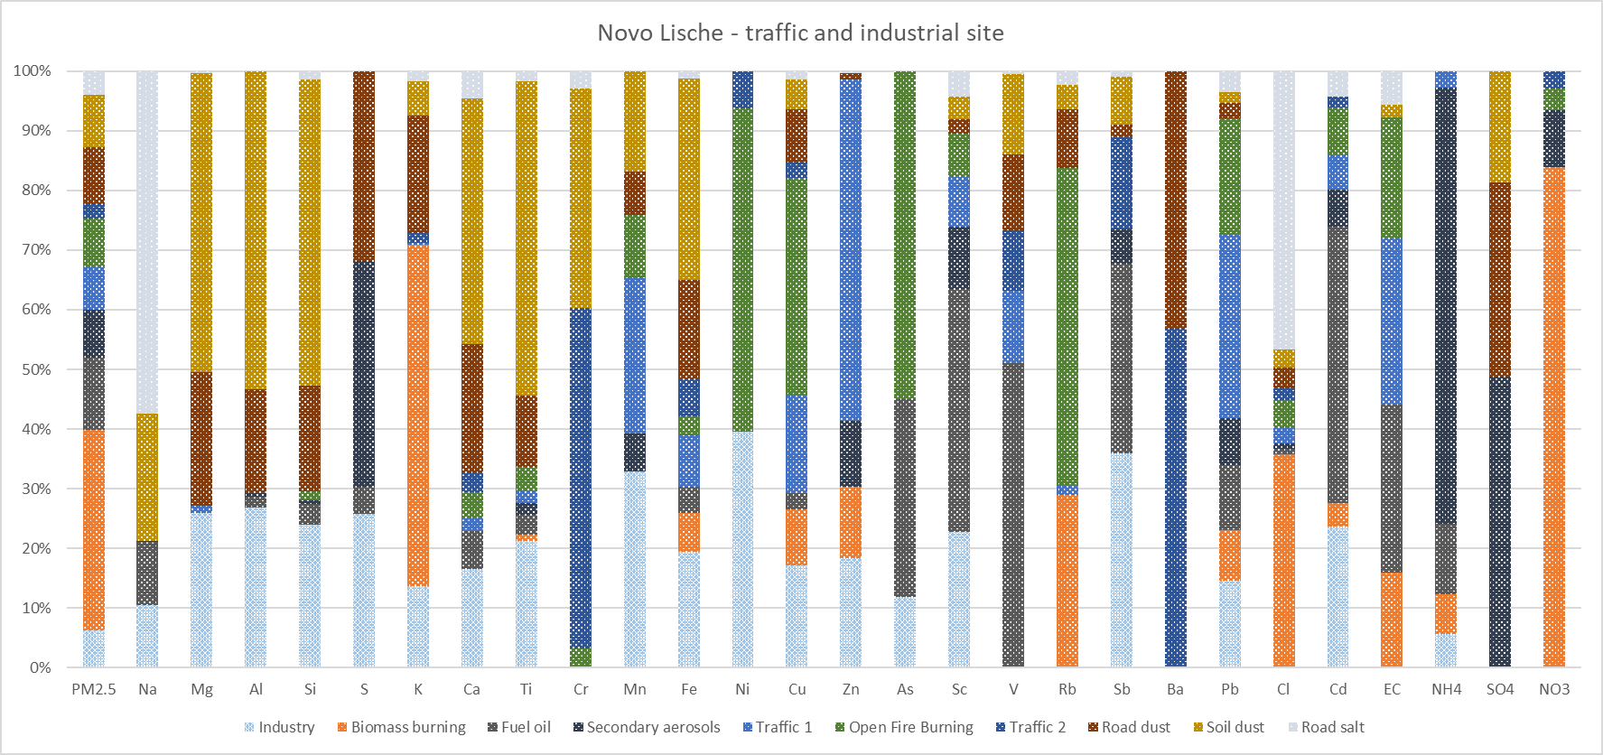
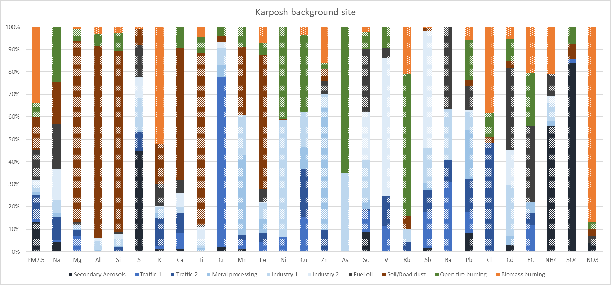
Positive Matrix Factorization (PMF) Model
Using the modelling exercise's results, the contribution of each source to total particulate mass (PM 2.5) was determined.
In order to provide the most "real world" plausible solution, traffic and industry-related factors were organised into complex sources, resulting in seven major sources for each site.
The principal sources identified were; biomass combustion, traffic, open fire combustion, secondary aerosols, soil/mineral dust, industry and fuel/residual oil combustion.
Notes:
As mentioned above, the free software US-EPA PMF 5.0 with ME-2 algorithm, was used for this study. Using the modelling exercise's results, the contribution of each source to total particulate mass (PM 2.5) was determined. The principal sources identified were; biomass combustion, traffic, open fire combustion, secondary aerosols, soil/mineral dust, industry and fuel/residual oil combustion.

Slide 20

Positive Matrix Factorization (PMF) Model
Using the modelling exercise's results, the contribution of each source to total particulate mass (PM 2.5) was determined.
In order to provide the most "real world" plausible solution, traffic and industry-related factors were organised into complex sources, resulting in seven major sources for each site.
The principal sources identified were; biomass combustion, traffic, open fire combustion, secondary aerosols, soil/mineral dust, industry and fuel/residual oil combustion.
Notes:
Using the modelling exercise's results, the contribution of each source to total particulate mass (PM 2.5) was determined.
The principal sources identified were; biomass combustion, traffic, open fire combustion, secondary aerosols, soil/mineral dust, industry and fuel/residual oil combustion.

Slide 21
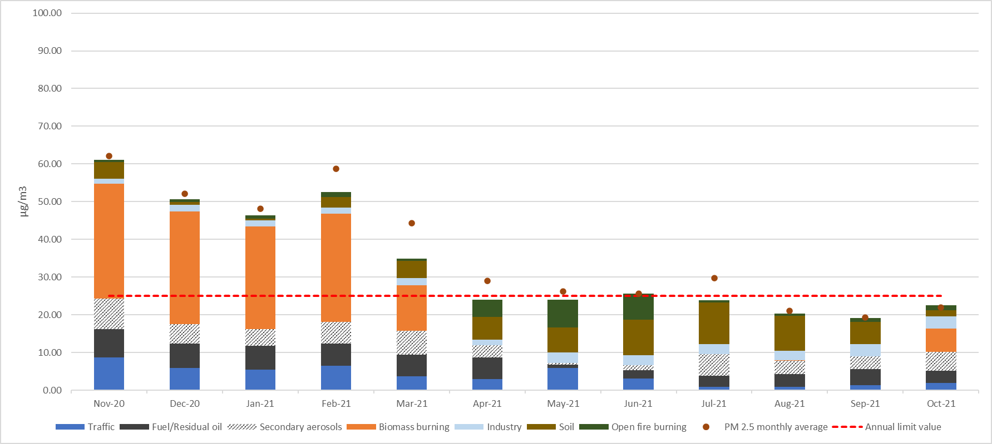
Modelled monthly mass contribution – Karposh urban background site
Notes:
We were able to obtain monthly mass contribition for each site. The principal sources identified were; biomass combustion, traffic, open fire combustion, secondary aerosols, soil/mineral dust, industry and fuel/residual oil combustion.

Slide 22
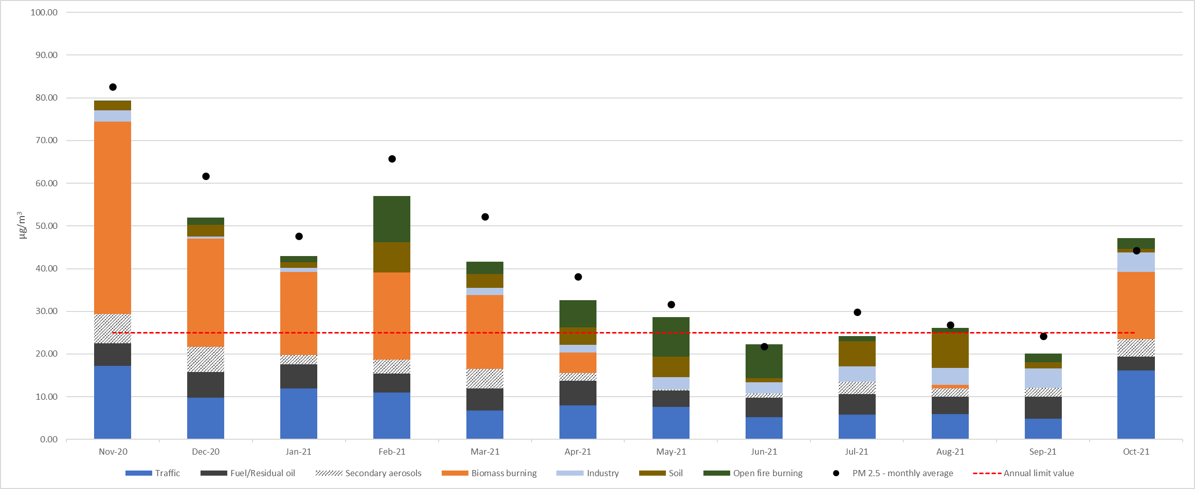
Modelled monthly mass contribution – Novo Lisiche traffic & industrial site
Notes:
Sources contribution are similar for both sites with few exceptions.

Slide 23

Discussion
During the winter months (Nov, Dec, Jan, Feb and March) biomass burning was a major source at both sites, with average monthly contribution ranging between 17.41 and 45.07 μg/m³ for Novo Lisice exposed site, and 12.16 and 30.42 μg/m³ for Karpos background site. This source alone, contribute above the annual limit values.
Notes:
During the winter months biomass burning was a major source at both sites, and although strictly seasonal, this source alone, contribute above the annual limit values.

Slide 24
Discussion
Traffic is the second most important source for the Novo Lisice site, with a consistent contribution between 4.82 and 17.21 μg/m3 during the year, but a variable and substantially lower contribution at the Karpos site ranging from 0.86 and 8.69 μg/m3.
Notes:
Traffic is the second most important source for the Novo Lisice site, but shows variable and substantially lower contribution at the Karpos background site.

Slide 25
Discussion
Fuel/residual oil range from 3.28 and 5.98 μg/m³ at Novo Lisice and 0.84 and 7.54 μg/m³ at Karpos site, while industrial sources exhibit slightly lower contribution ranging between 0.33 and 4.59 μg/m³ at Novo Lisice and 1.33 and 3.35 μg/m³ at Karpos site. Both are consistent over the year.
Notes:
Fuel/residual is 3 largest source, while industrial sources exhibit slightly lower contribution, but both are consistent over the year.

Slide 26
Discussion
Soil dust has highest contribution over the summer months, ranging from 0.33 and 8.22 μg/m³ at Novo Lisice and 0.54 and 10.97 μg/m³ at Karpos background site.
Notes:
Soil dust has highest contribution over the summer months, and can contribute up to 45 % of total mass during those months.

Slide 27
Discussion
Open fire burning is detectable over the entire year, with largest contribution in spring and early summer months and range from 0.16 and 10.78 μg/m³ at Novo Lisice and 0.56 and 7.32 μg/m³ at Karpos site.
Notes:
Open fire burning has largest contribution in spring and early summer months and can contribute up to 35 % of total particulate mass during this months.

Slide 28
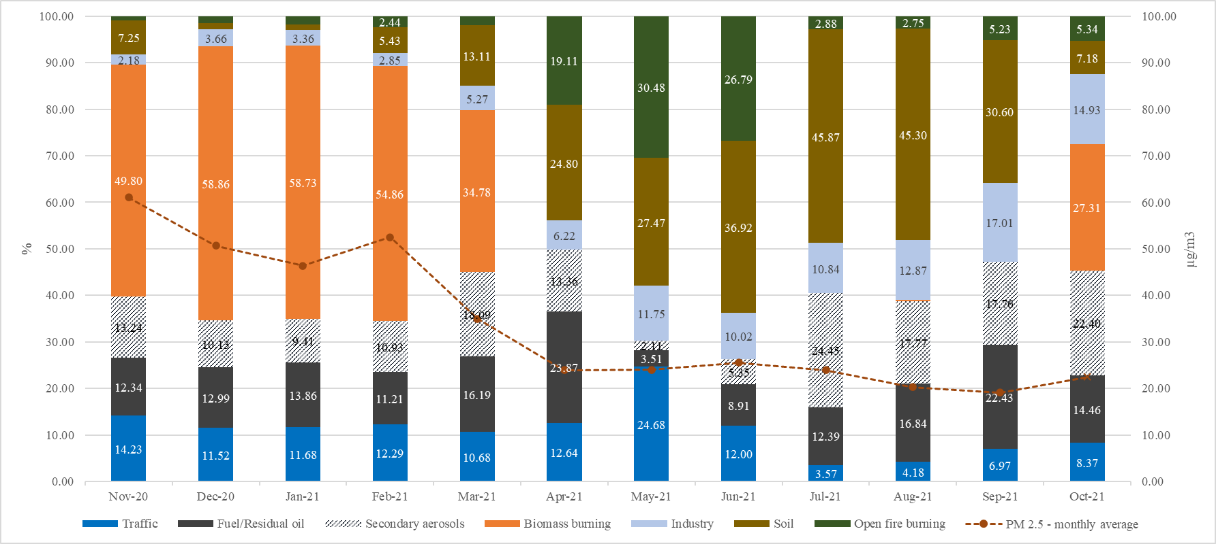
Relative monthly mass contribution – Karposh urban background site

Slide 29
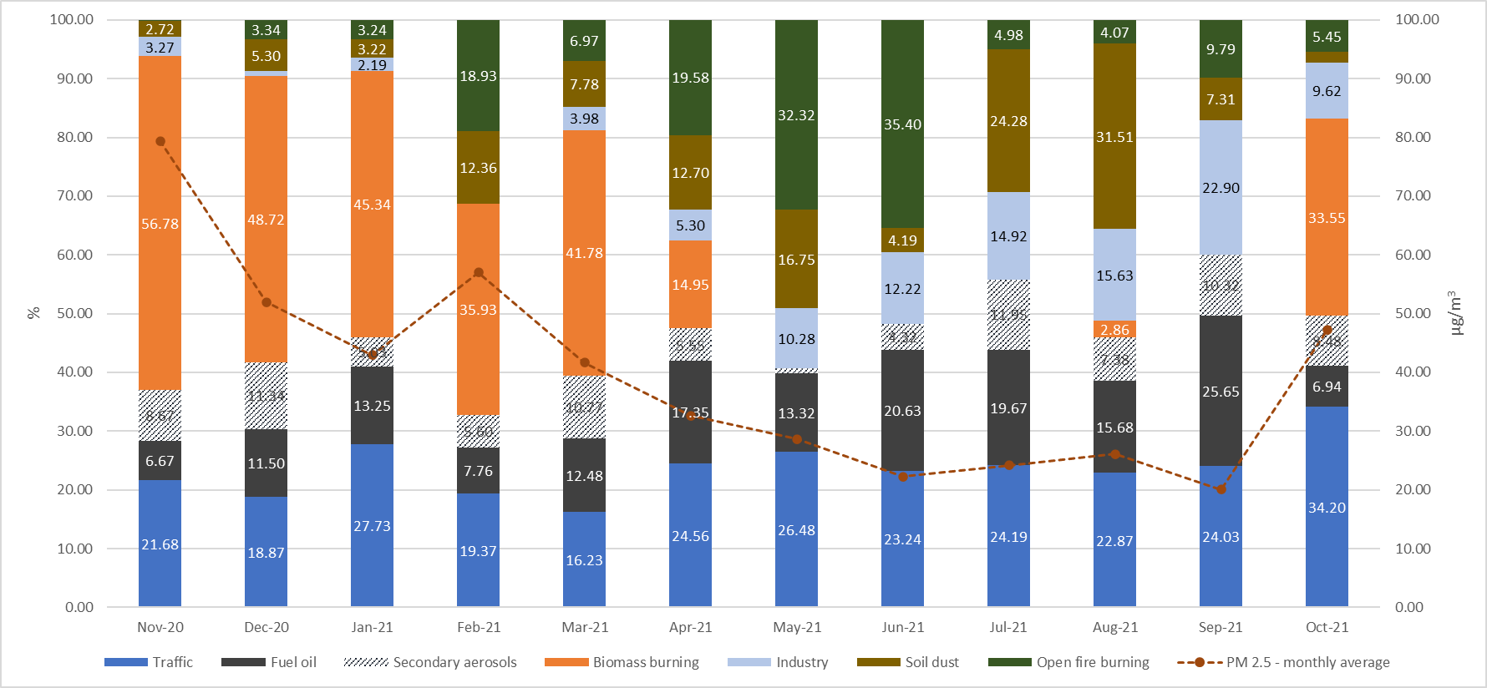
Relative monthly mass contribution – Novo Lisiche traffic & industrial site

Slide 30
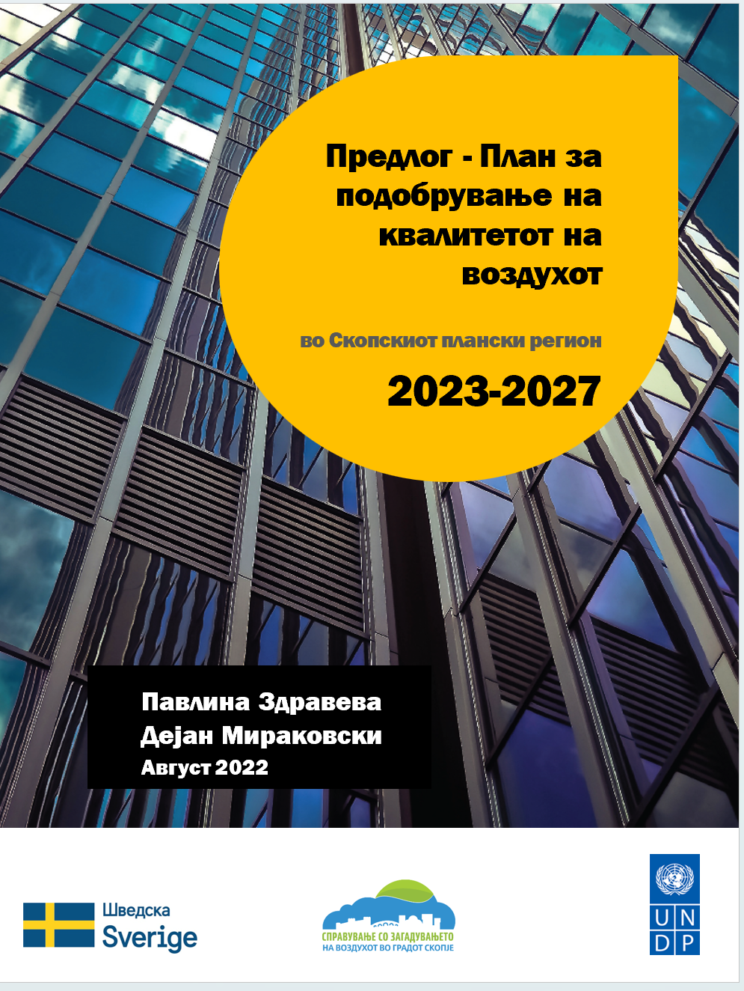
Conclusions
Biomass combustion continues to be the largest single source of ambient air pollution and, due to its particular temporal distribution, is most likely the primary cause of extreme wintertime pollution episodes. Therefore, there should be a major emphasis on exchanging heat sources and improving energy efficiency, particularly in single-family homes, notwithstanding the difficulties involved with massive informational and direct financial support initiatives.
Other key sources, like fuel/residual oil burning, soil dust, and open fire burning, can and must be addressed in a much shorter time frame.
Notes:
Biomass combustion continues to be the largest single source of ambient air pollution and, due to its specific temporal distribution, is most likely the primary cause of extreme wintertime pollution episodes. Having in mind difficulties involved with massive informational and direct financial support initiatives, a lot of efforts are needed to see the improvements.
However, other key sources, like fuel/residual oil burning, soil dust, and open fire burning, can and must be addressed in a much shorter time frame.
I should also mention that we use the SAS results to draft AQIP for Skopje, and using temporal source distribution data from the study believe we did well rounded - four season AQIP plan with mesures adopted to the season and specific sources.
Thanks for your attention.

