Slide 1
Individual heating - lessons learnt from demonstration model in Lisice, City of Skopje, and analysis of subsidy models
29 May 2023

Slide 2
Tackling the Air Pollution in the City of Skopje
Project aim: to demonstrate a multi-pronged intervention to tackle air pollution in the city of Skopje linked to the residential sector. Its objective is to establish a fully functional platform that brings all traditional and non-traditional partners to work together to address the issue. UNDP implements the project in partnership with the Ministry of Environmentt and Physical Planning, the City of Skopje and University “Goce Delcev”, Stip.
Financial support provided by Government of Sweden in amount of 2,056,766.75 USD Project period: December 2019 – September 2022.

Slide 3
Project components
Component 1. Comprehensive monitoring system (for the pilot area) as well as coordination platform to tackle air pollution developed and put in function.
Component 2. Regulatory changes necessary to transition towards a lower emission household energy systems developed and presented to the respective institutions.
Component 3. Measures that address the causes of air pollution for household heating to show proof of concept demonstrated in at least 100 households.
Component 4. Public awareness raised regarding the air pollution causes and effects, as well as the impact of energy efficiency measures.

Slide 4
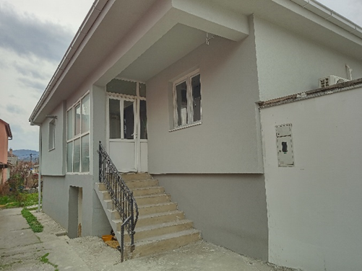
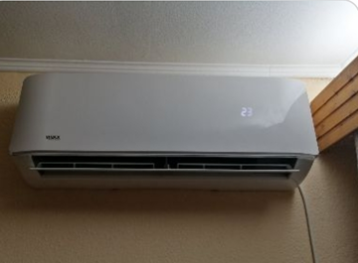
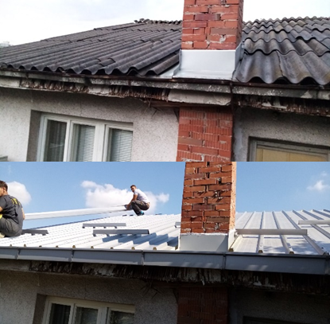
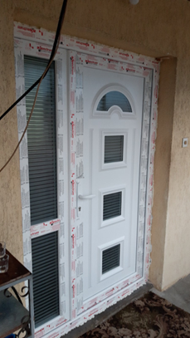
Demonstration of measures to show proof of concept
In total 129 households from Lisice, were supported to replace their old and inefficient heating devices, and to implement various energy efficiency measures
Additional 270 socio-economically vulnerable households in Skopje were supported to replace their old heating devices with new energy efficient ones

Slide 5
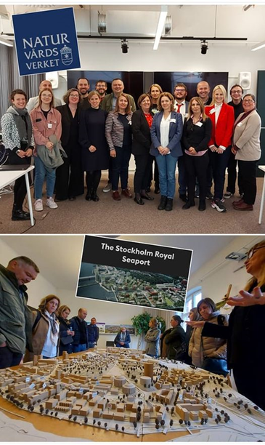
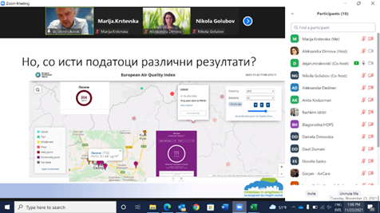
Building public awareness and increasing knowledge

Slide 6
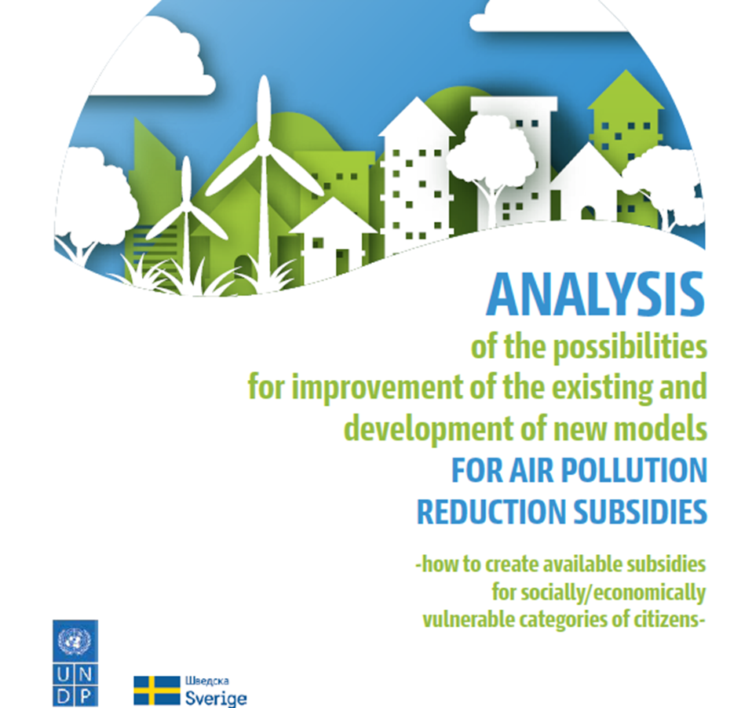
Air Pollution cistvozduh.mk
Inclusion of socially / economically vulnerable categories of citizens and proposing measures for their subsidizing using existing laws, government programs, programs of the Ministries and of the local self-government units
Legal consistency/Unification of legal terminology regarding the categorization of socially / economically vulnerable categories of citizens
Introduction of the possibility for applicants to apply without having to buy the product themselves
Setting fewer and clear criteria in the calls for implementing the measures that will be understandable to the citizens that should apply
Have a transparent applicant scoring system based on previously set objective criteria.

Slide 7
Air Pollution reduction subsidies - continued
Providing applicant support (in all segments of the subsidy process) via involving the non-governmental sector, and the social care centers.
Explore a possibility for including energy auditors to provide the necessary technical assistance to the citizens at risk interested in the calls.
Timely informing (multi-channel information system) of target citizens about the existing measures and the terms of applying and exercising their right to a subsidy.
Strengthening the communication and coordination between all involved entities on central and local level
Building intra-organizational capacities of the local governments for implementation of the subsidy measures

Slide 8
Lessons learnt
The model applied is not the most suitable one to be implemented through donor projects that have limited time and funding and could reach only limited number of beneficiaries. It is recommended this kind of subsidy model to be set within the respective national/local institutions and to be implemented on regular basis
The perception that the biomass is the cheapest energy source is difficult to be changed, especially during the period of global economic and energy crisis. Hence, the activities for behavior changing and public awareness raising must accompany any subsidy programme
Data from the air monitoring has to be accurate, reliable, accessible and presented in a way understandable for the public
Tackling the air pollution should be multi sectoral and a whole of a society set of actions (central and local governments, academic and research institutions, CSO, citizens)

Slide 9
Thank you for your attention
anita.kodzoman@undp.org
aleksandra.Dimova@undp.org
https://cistvozduh.mk/en/

